Slide 1
Optical Illusions
Mary Pate & Emory Gatchell

Slide 2
Expanding your knowledge
In class: we looked at optical illusion examples with and without the 3D glasses and saw how our eyes were deceived.
In our presentation: we will explain the science behind how optical illusions work and what happens in your brain.

Slide 3
background
When you look at something, all you see is the light reflected off of it from a source of light. The light reflected off the object goes into your eye, which is then converted into electrical signals that are interpreted by your brain. Your brain then interprets that image and that is what you see. This process takes about 1/10 of a second so your brain is interpreting what you see 10 times every second and regenerating the images.

Slide 4
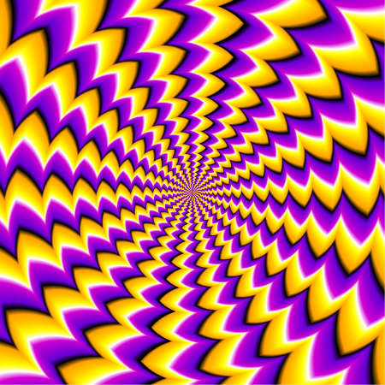
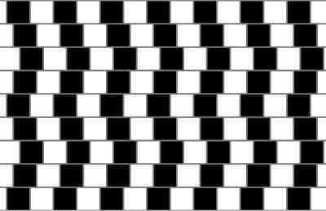
What are optical illusions?
“something that deceives the eye by appearing to be other than it is” dictionary.com
We will explain how optical illusions deceive your brain, and why you see what you see

Slide 5
Why you see what you see
It is difficult for a brain to try to focus on many things at once so the brains’ visual cortex makes assumptions, simplifying what we see to concentrate on what’s important. This shortcut helps humans see things that happen quickly so that their brain sees it and interprets it.

Slide 6
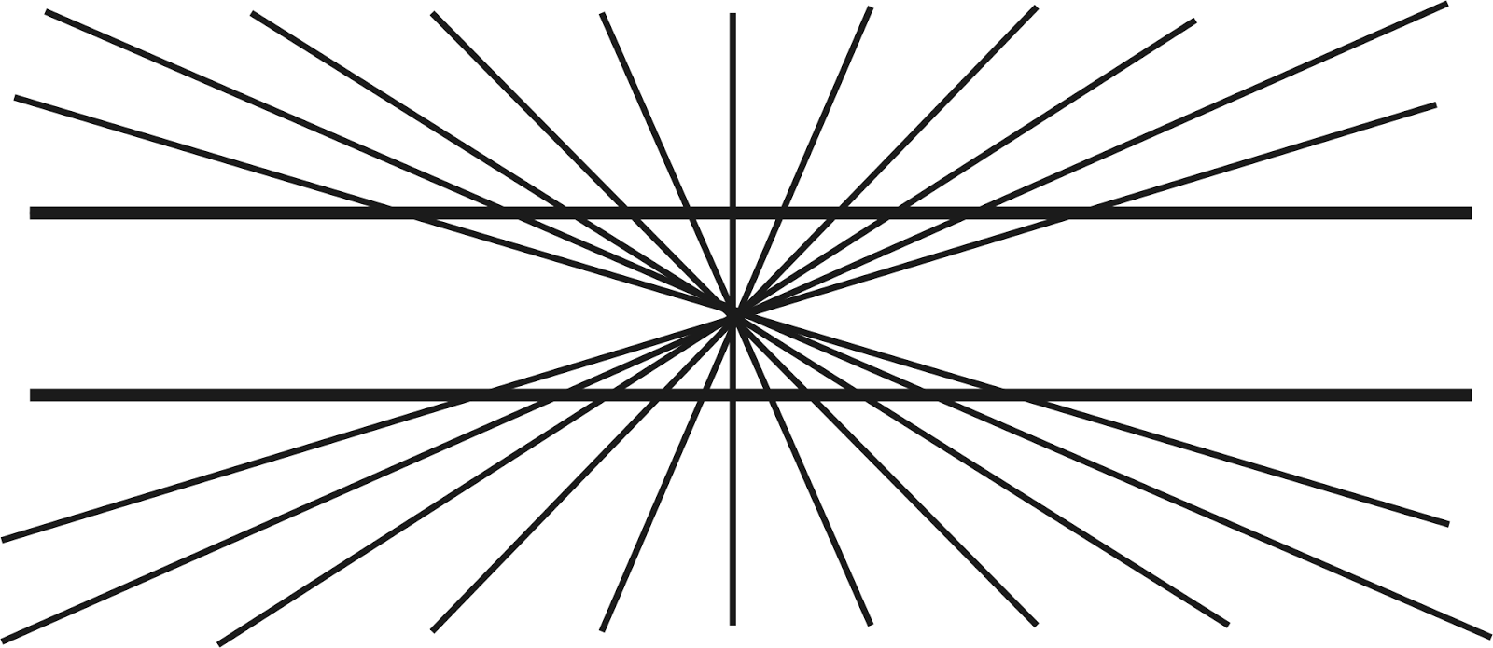
Heriing Illusion
In the Hering illusion, there are 2 straight lines, but once you put them in front of a radial pattern, the lines begin to look curved in, even though they are straight.
When you see the point in the middle, your eyes focus on it, making all of the vertical lines look like they are going towards the middle, but the horizontal lines look like they are diverging away from the center point.

Slide 7
Mach bands illusion
While it looks like the beams are going from darker → lighter from right → left, you can see that all of the beams are a solid color once they are separated.
This is caused by lateral inhibition: a process which distinguished the lines and boundaries of shapes. This quality comes from back when humans were hunters and they would not be able to focus on all shapes and colors inside of every object, so they would just focus on outlines (example: if they were looking at a swamp and saw the outline of a crocodile, they would be able to distinguish it from the swamp, but if they just saw the green of a crocodile in the dark lake, it would just look like a blur.
Lateral inhibition causes us to focus on outlines, and when one compares one color with the color to the left, it looks darker, which causes the brain to interpret it that way, but when we take the same color and compare it to the color on the right, it looks lighter, which causes our brain to interpret it this way.
This effect is what causes the bars to look hombre

Slide 8
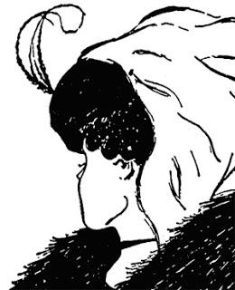
Old woman/ young girl illusion
In this illusion, there is an old woman and a young girl in the same picture. Your brain will determine which person you see.
Once the brain has the information that it has perceived (light), it bases what you see on 2 things: memory and interpretation.
If you have already seen this illusion before and can only see the girl, it is likely that you will see the girl again,
If you have never seen this illusion, then whichever one you interpret first will likely stick with you

Slide 9
Muffin tin illusion
A brains visual cortex makes assumptions because it’s doing a ton of things at once
Humans expect light to come from a high angle. The way the shadows work in this picture leads us to believe that the outside circles are concave and the middle circle is convex. (left picture)
When the picture is flipped over (right picture), the outside circles look like they are convex whereas the middle circle looks like it is concave.

Slide 10
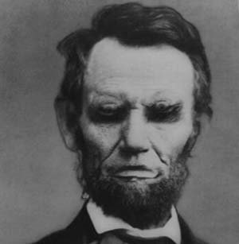
Upside down Lincoln
Humans recognize faces by the mouth and the eyes, so in this picture, Lincoln looks normal because his eyes and mouth are right side up, but when flipping the picture over, you realize that it looks wrong.

Slide 11
Bibliography
https://www.google.com/search?q=mach+bands+illusion&rlz=1C1NHXL_enUS708US708&espv=2&biw=1242&bih=580&source=lnms&tbm=isch&sa=X&ved=0ahUKEwi58ue8r8fRAhVs9YMKHSW7CSIQ_AUIBygC#imgrc=0D9FZ6q2ExIt_M%3A
https://www.google.com/search?q=mach+bands+illusion&rlz=1C1NHXL_enUS708US708&espv=2&biw=1242&bih=580&source=lnms&tbm=isch&sa=X&ved=0ahUKEwi58ue8r8fRAhVs9YMKHSW7CSIQ_AUIBygC#imgdii=0D9FZ6q2ExIt_M%3A%3B0D9FZ6q2ExIt_M%3A%3BRs7X6jnMMKeZTM%3A&imgrc=0D9FZ6q2ExIt_M%3A
https://www.google.com/search?q=lateral+inhibition+illusions&rlz=1C1NHXL_enUS708US708&espv=2&biw=1242&bih=580&source=lnms&tbm=isch&sa=X&ved=0ahUKEwjD-6yTscfRAhVmjFQKHT9OCRQQ_AUIBigB#imgrc=Yi02UOqkUDLv6M%3A
https://www.google.com/search?q=duck+and+rabbit+illusion&rlz=1C1NHXL_enUS708US708&espv=2&biw=1242&bih=580&source=lnms&tbm=isch&sa=X&ved=0ahUKEwj11-a4sMfRAhXIzlQKHVmPBoAQ_AUIBigB#tbm=isch&q=old+woman+and+young+woman+illusion&imgrc=78h5yWiUNVbKwM%3A
https://www.google.com/search?q=cookie+tin+optical+illusion&rlz=1C1NHXL_enUS708US708&espv=2&biw=1242&bih=580&source=lnms&tbm=isch&sa=X&ved=0ahUKEwjO-4ujrsfRAhVLilQKHbScBi8Q_AUIBigB#tbm=isch&q=muffin+tin+optical+illusion&imgrc=S0wzUjxVv076BM%3A
https://www.google.com/search?q=cookie+tin+optical+illusion&rlz=1C1NHXL_enUS708US708&espv=2&biw=1242&bih=580&source=lnms&tbm=isch&sa=X&ved=0ahUKEwjO-4ujrsfRAhVLilQKHbScBi8Q_AUIBigB#tbm=isch&q=abe+lincoln+up+side+down&imgrc=3QjNWCvkx_b9QM%3A

